Slide 1



Ed Murashie
ProEngineered Solutions
NGSS
Motivation
_________________
Success!
Satellite Imagery

Slide 2
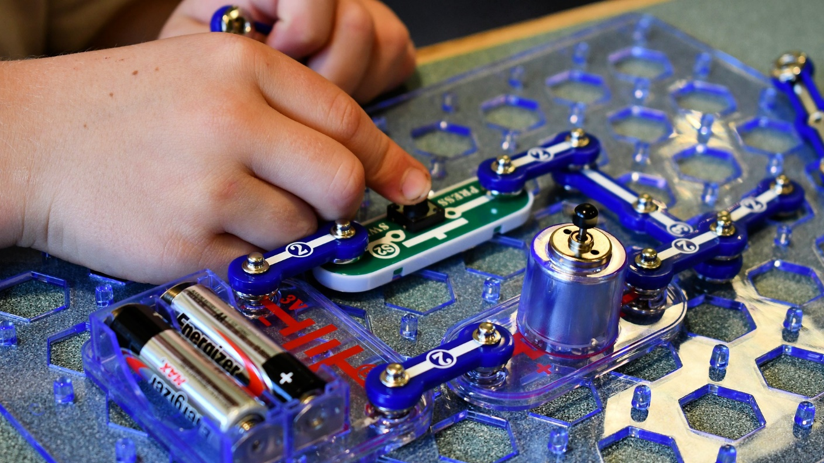

Slide 3

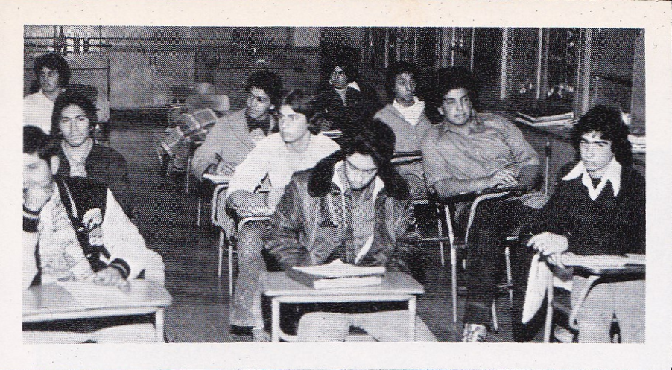
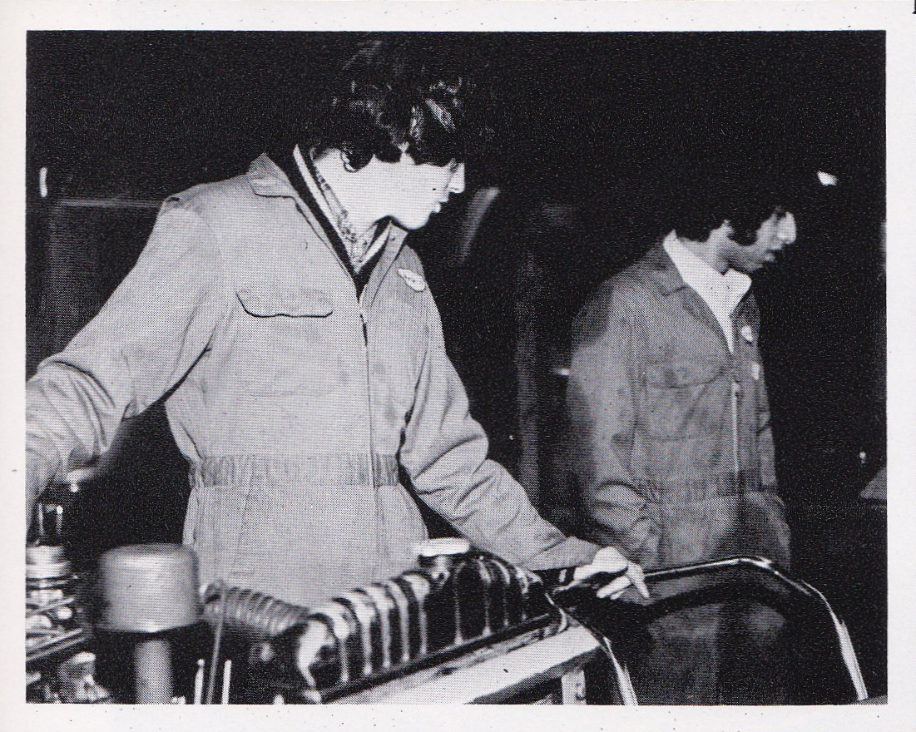
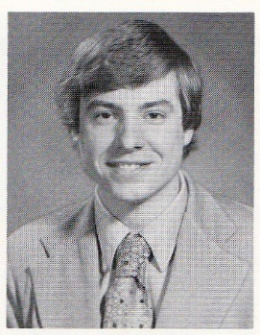
Cal Poly
1985
Don Bosco
1974

Slide 4

VS

Slide 5

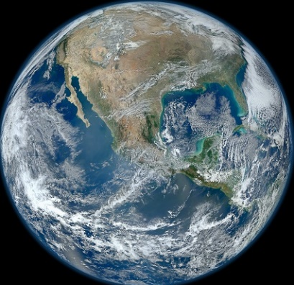

Slide 6

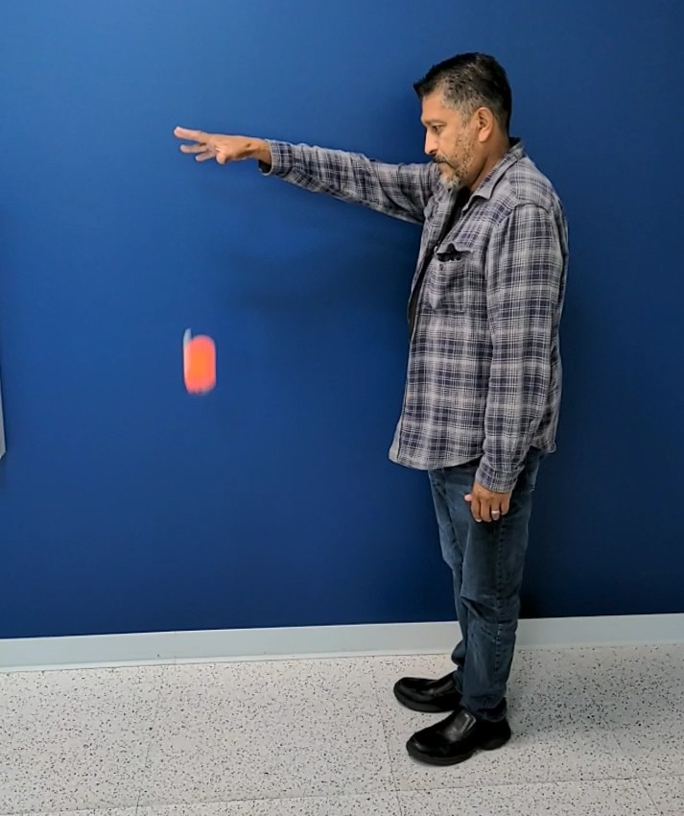
?

Slide 7
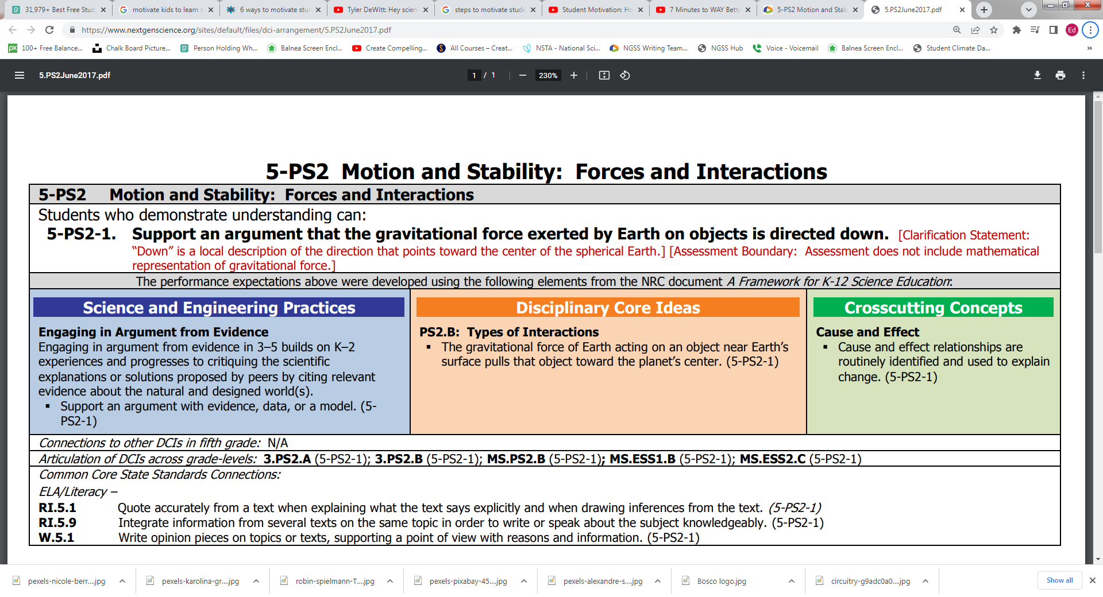
Next Generation Science Standards

Slide 9
New!
Analyze Interpret Data
Obtain Evaluate Communicate Info
Ask Questions
Construct Explanations
Models
Investigations

Slide 10
New!
Scale Proportion Quantity
Systems Models
Energy Matter
Structure Function
Stability Change
Patterns

Slide 11

Mile wide inch deep

Slide 12
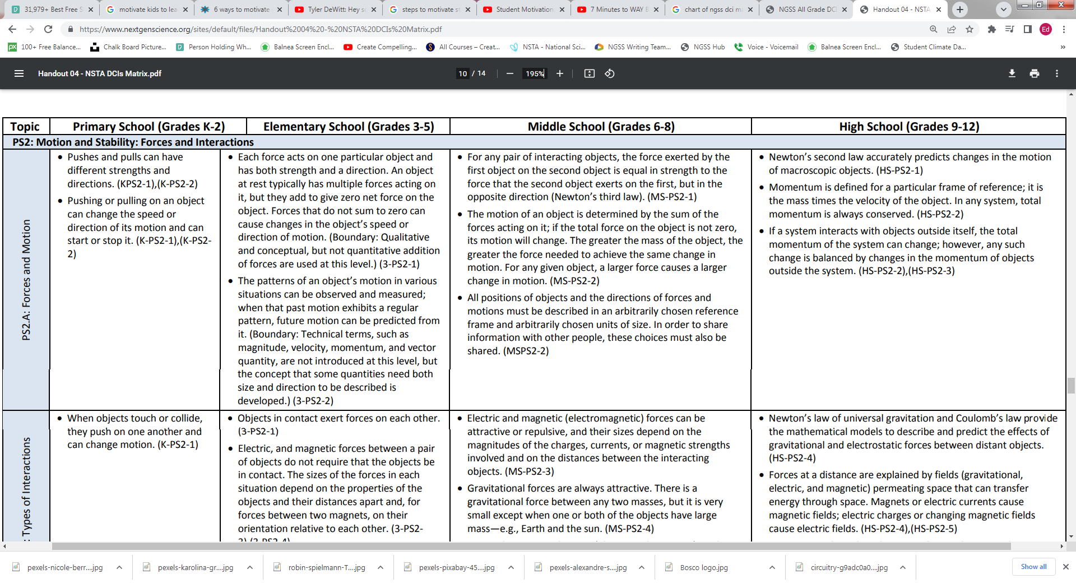
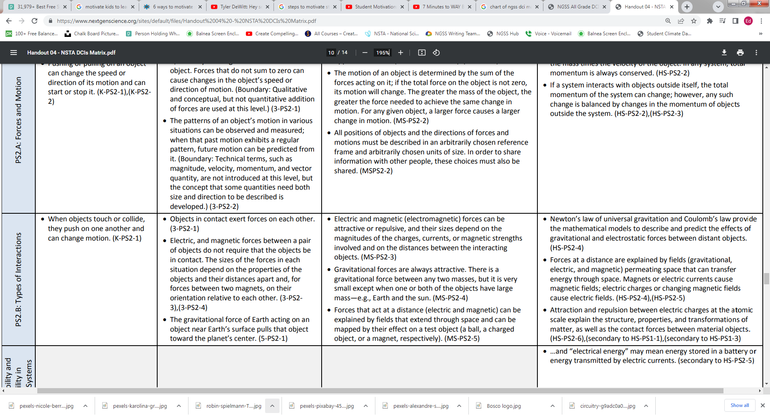

Slide 13
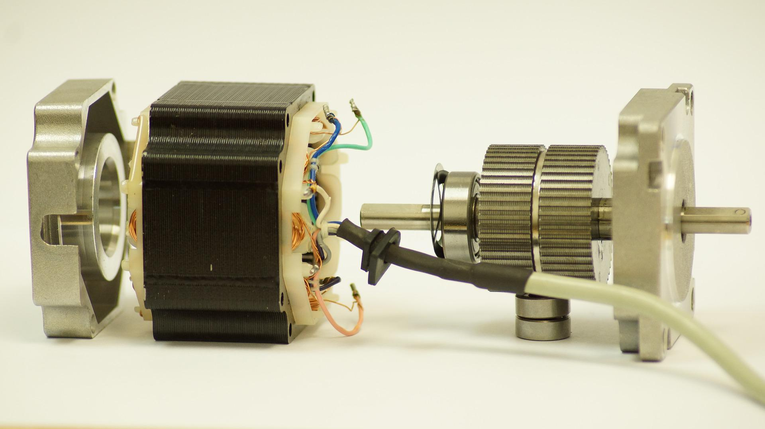
Gordon, Dale, the Motor, and 6%

Slide 16
Motivation Tips
Engaging Activities
Classroom Projects
Real Life – Current Events
Active Participation
Assignment Choice

Slide 17

NGSS Lesson Plans
Equipment & Data

Slide 18
Mon
Tues
Wed
Thurs
Fri
Waves Energy
GOES
Earth Systems GOES
Space Science JWT
Life Science Landsat
Physics
NOAA

Slide 19
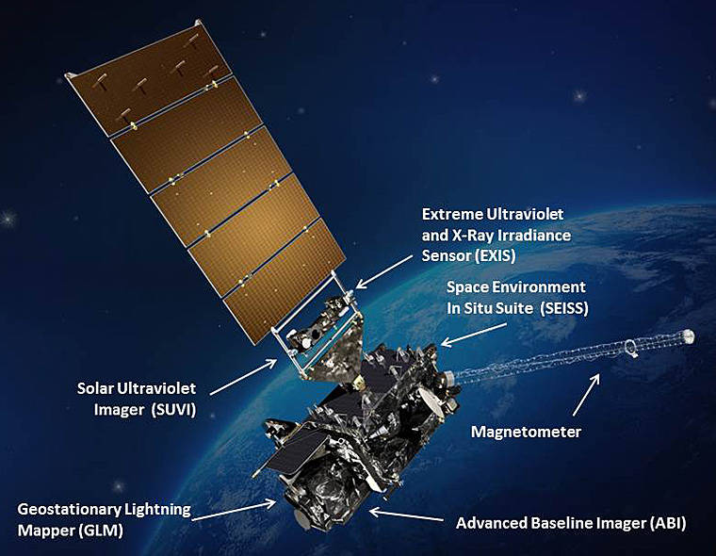
Dear SEA,
Congrats, you have been selected to design and launch the Next Gen weather satellite. But you must use NGSS.
Regards, NOAA/NASA

Slide 20
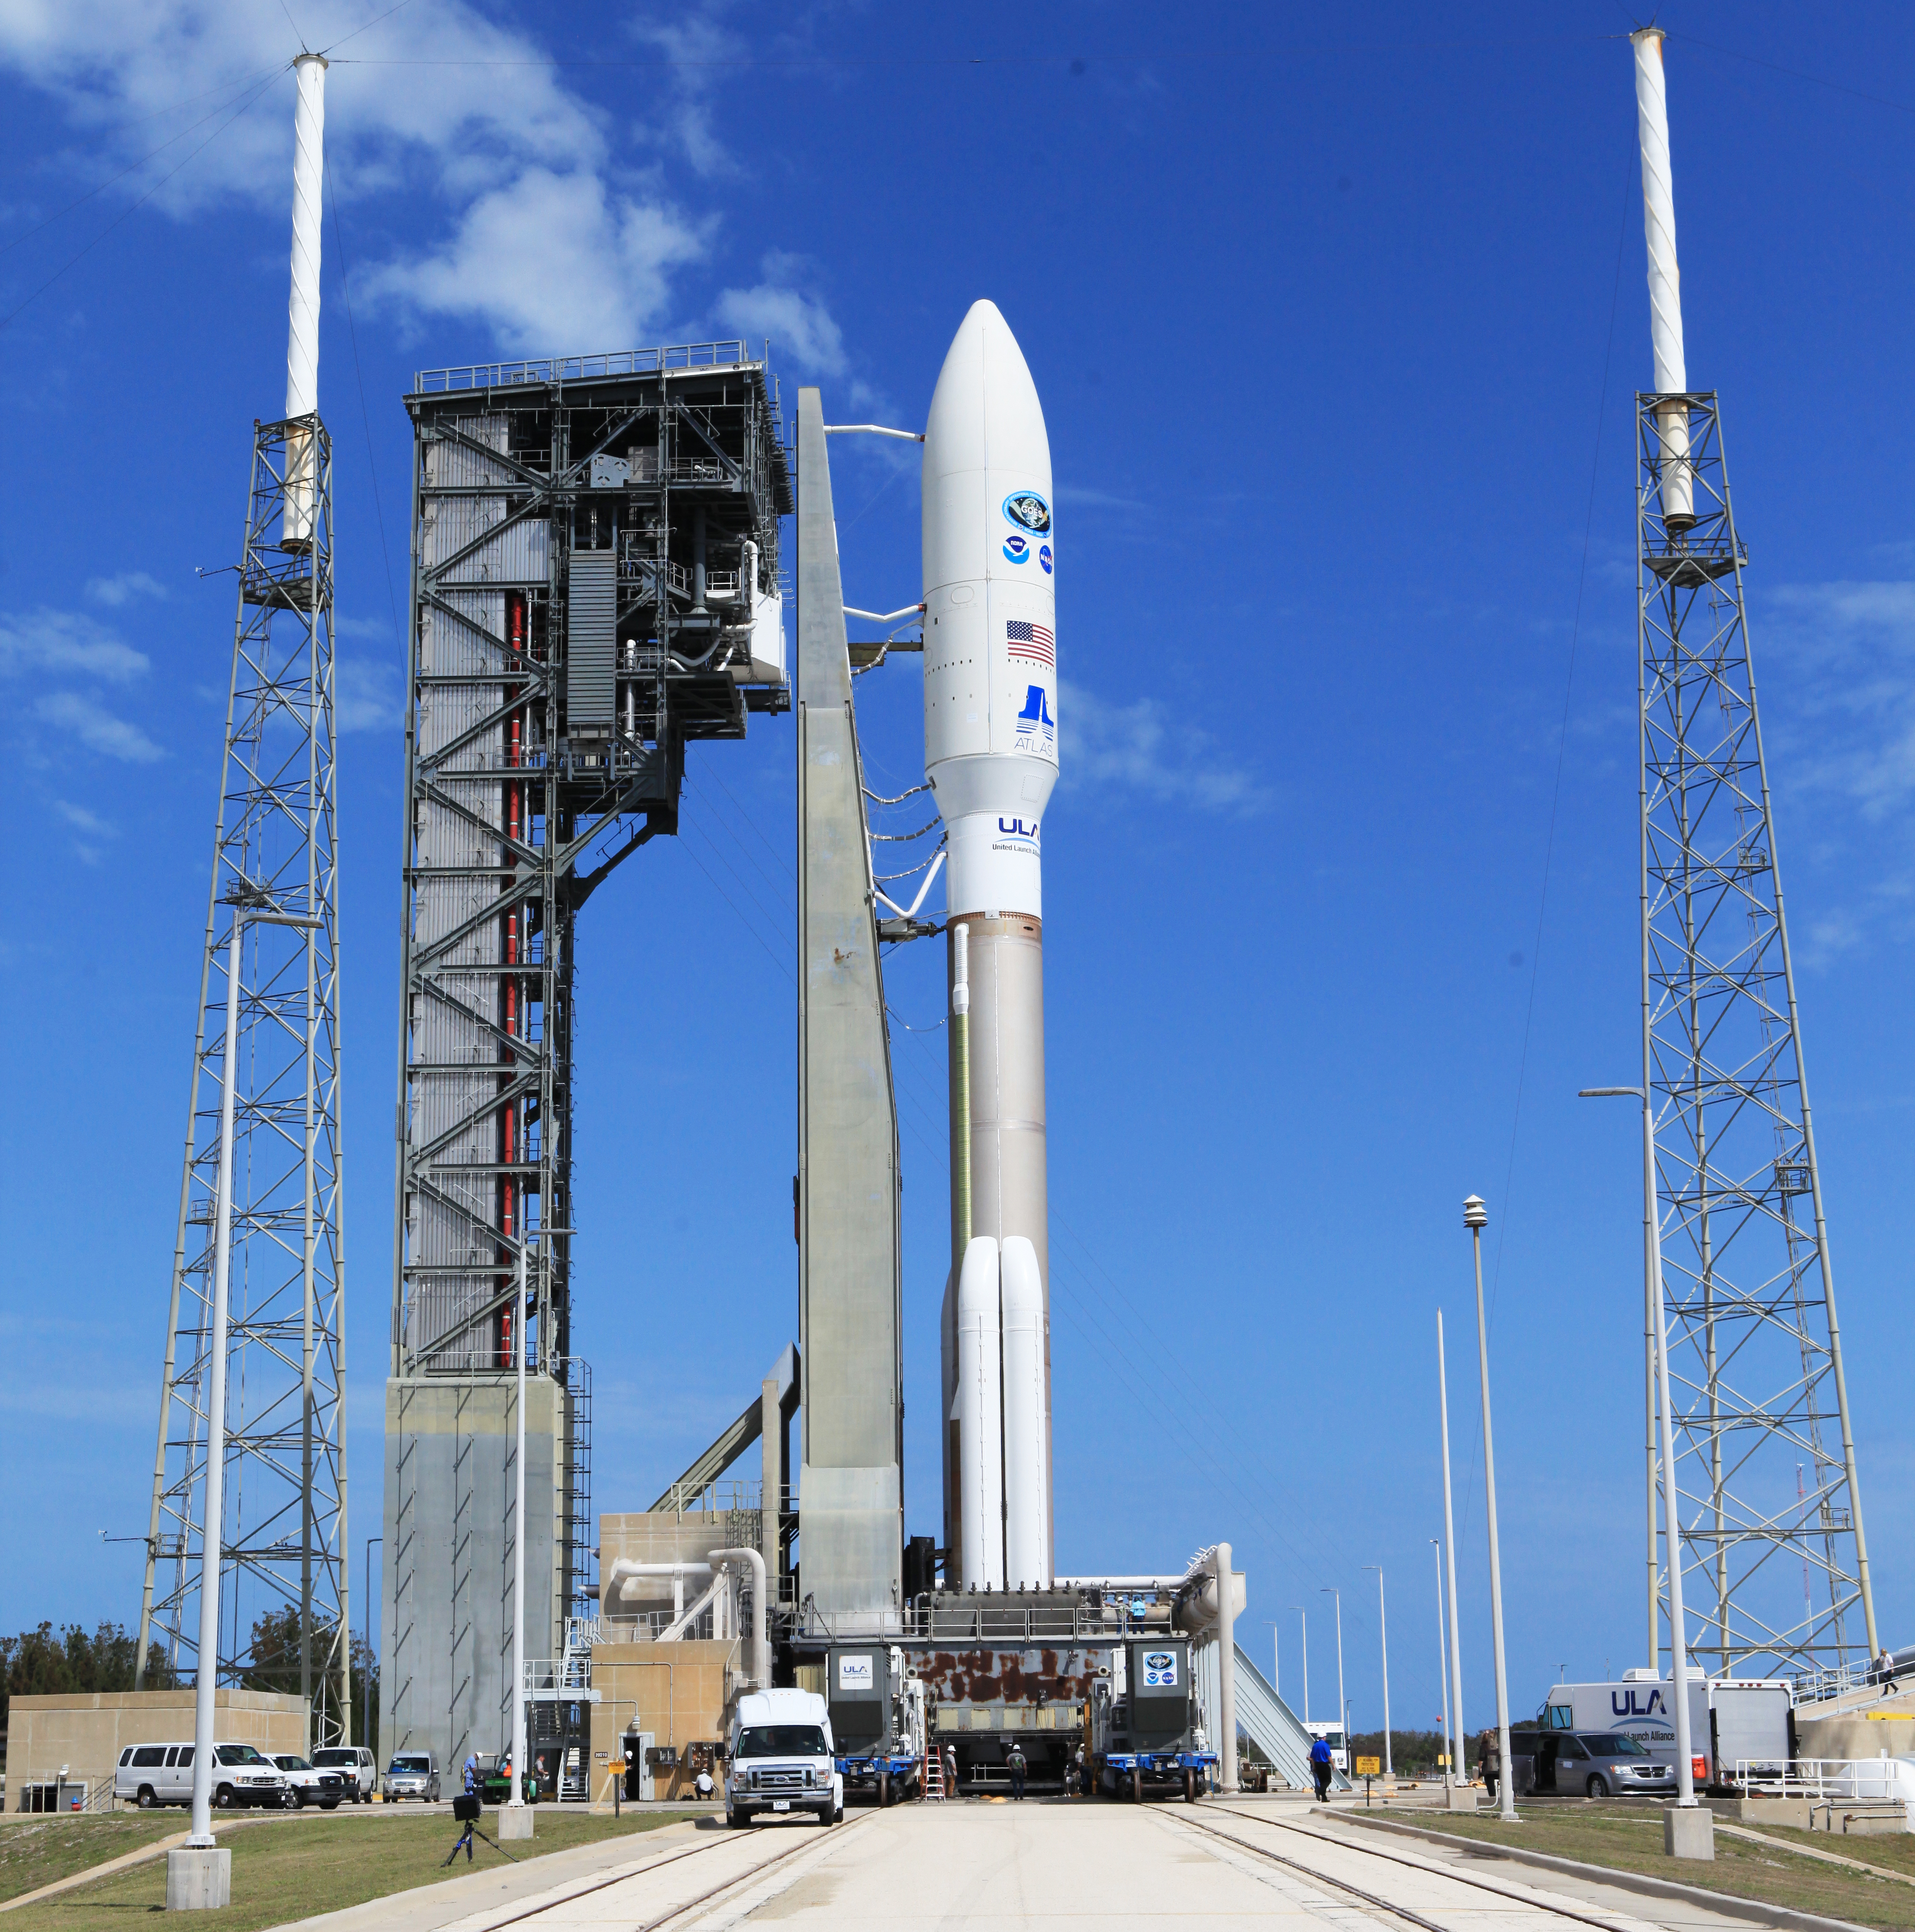
ULA Atlas V GOES-S
What do we tell them?
Credit: NASA

Slide 21
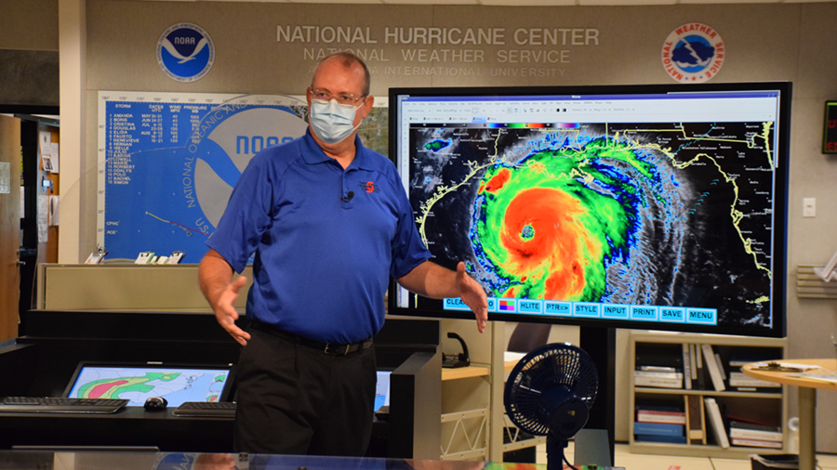

Slide 22
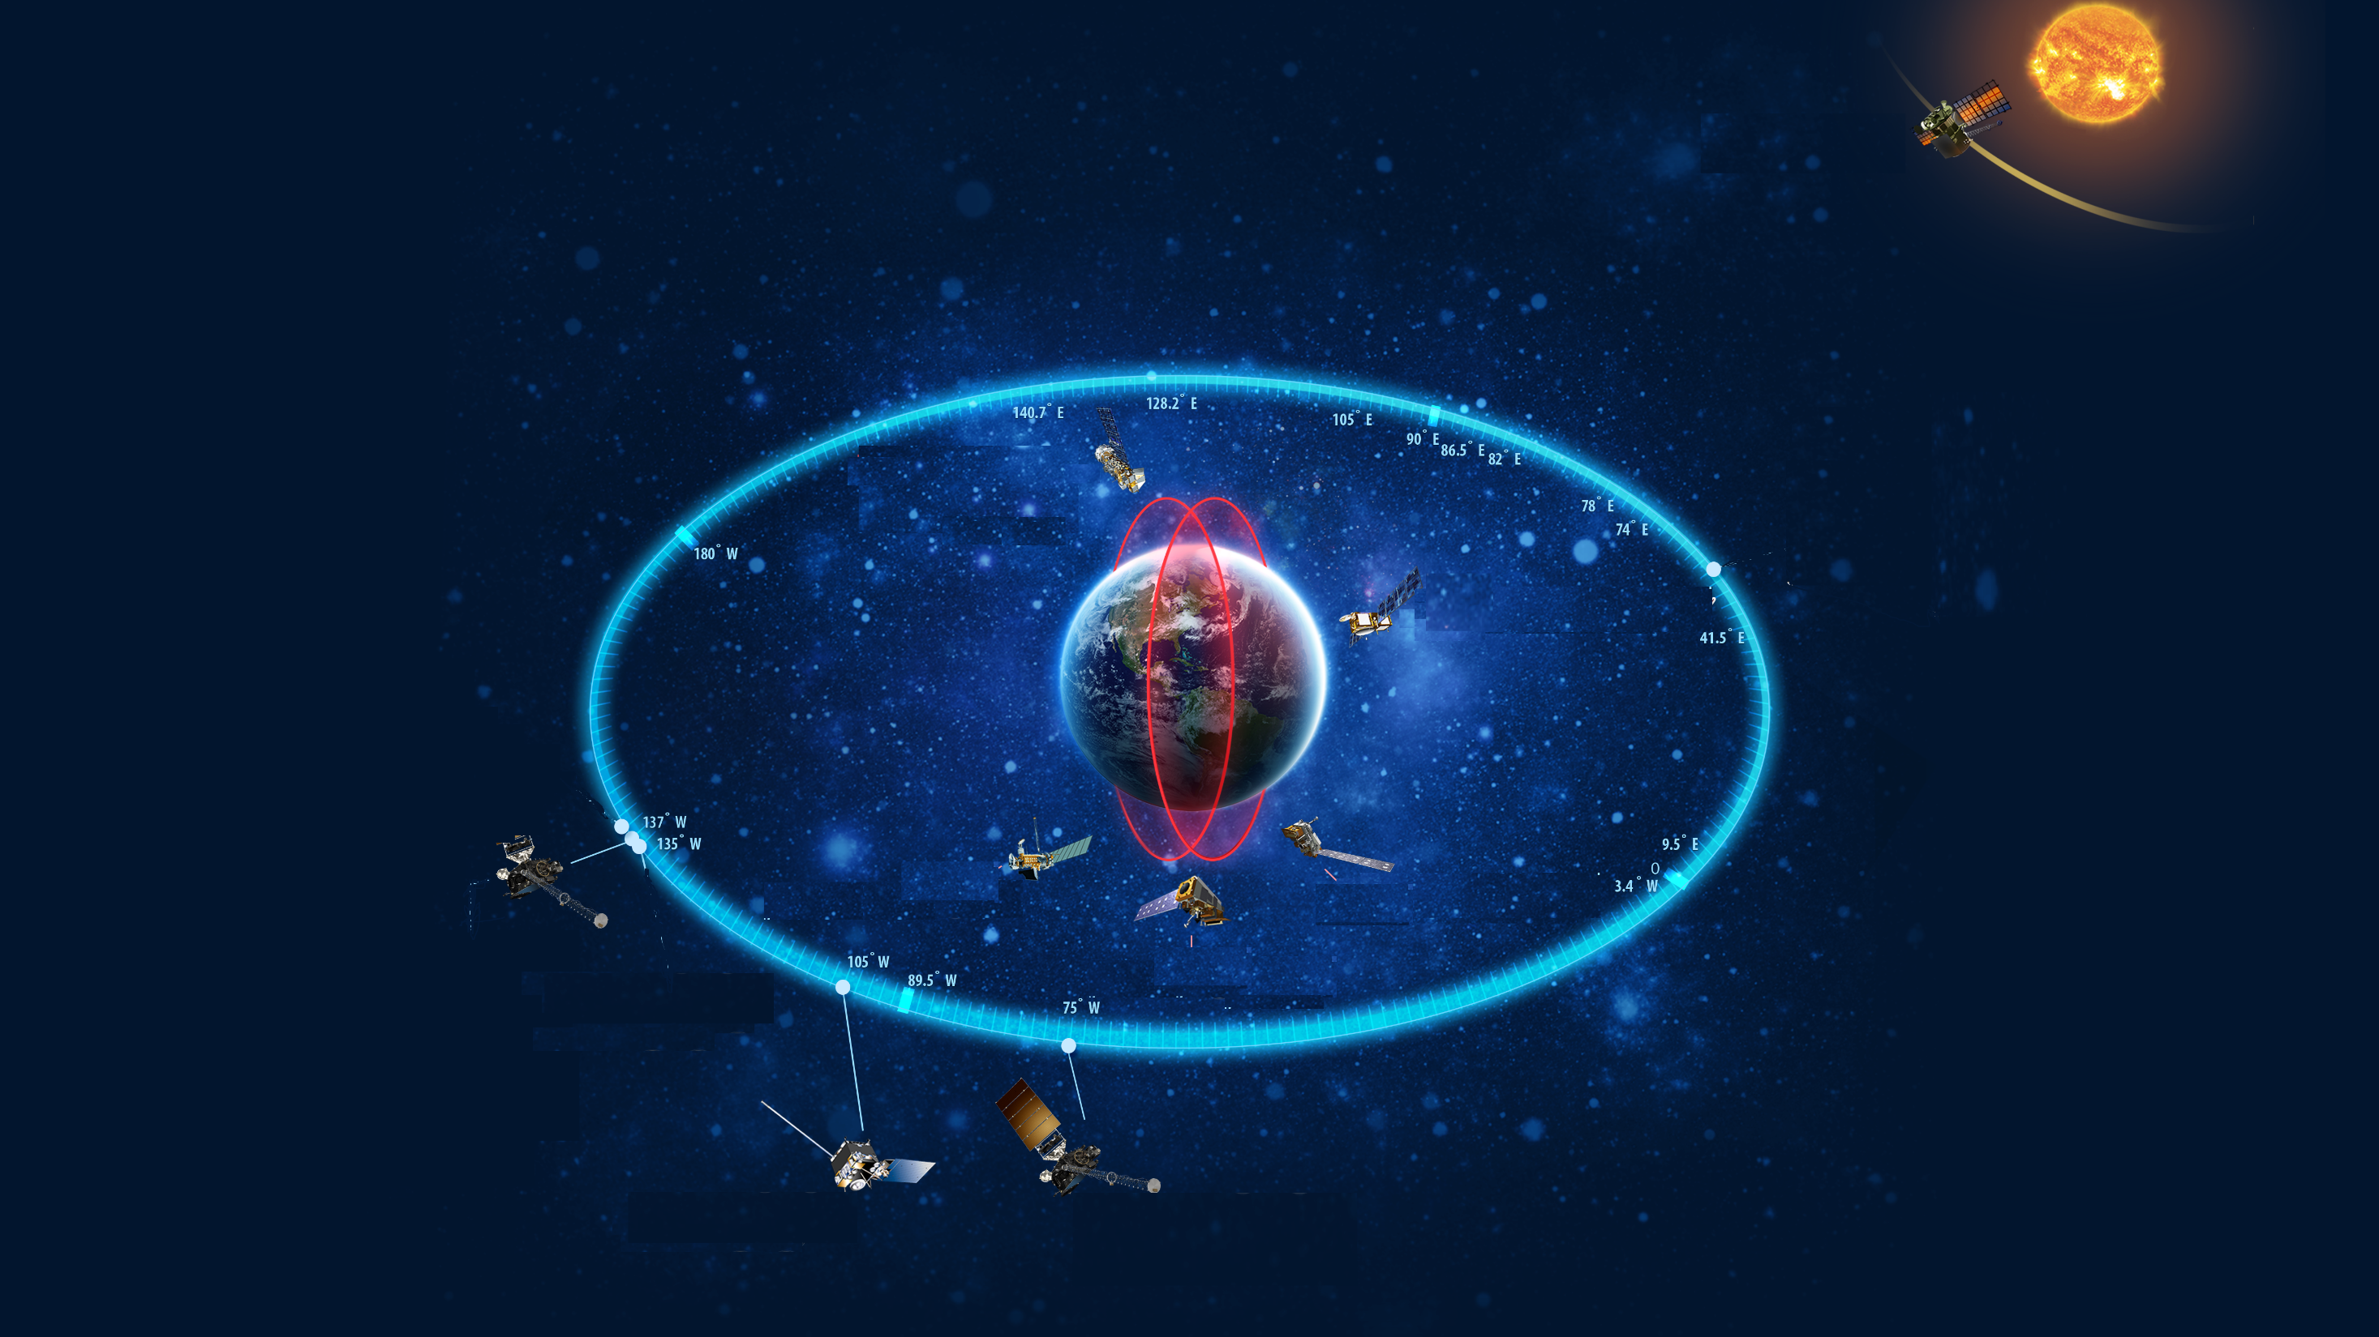
Orbits

Slide 23
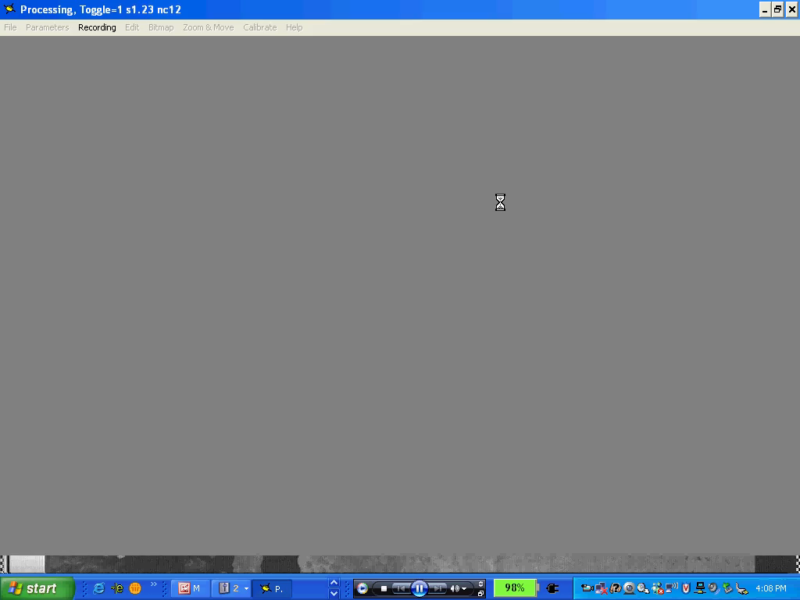
Low Orbit?
Geo Orbit?
Lagrange Orbit?

Slide 24
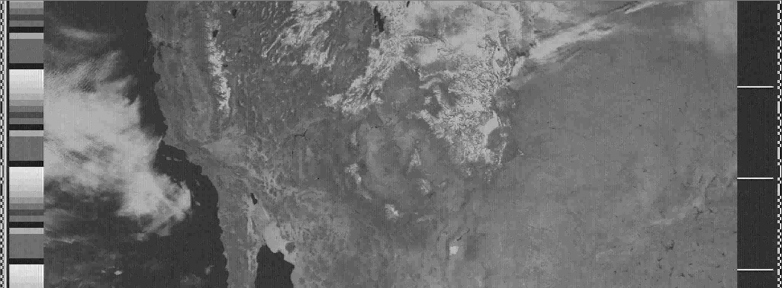
Low Orbit?
Geo Orbit?
Lagrange Orbit?

Slide 25
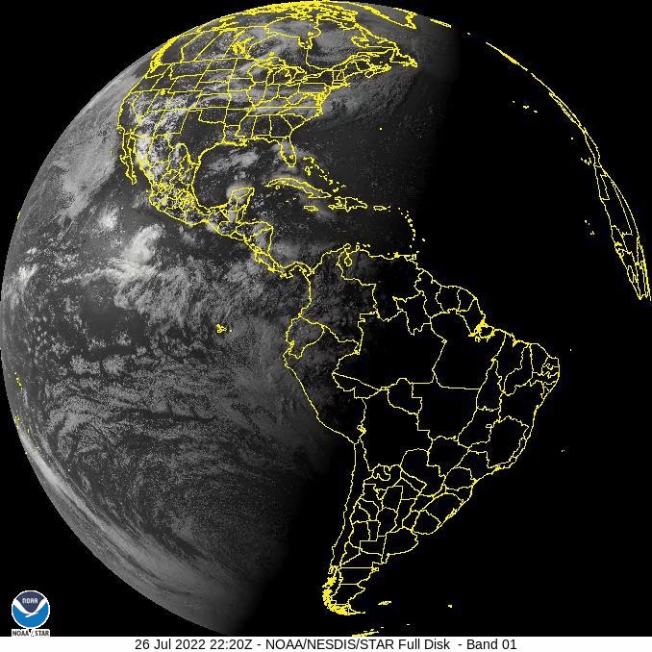
Low Orbit?
Geo Orbit?
Lagrange Orbit?

Slide 26
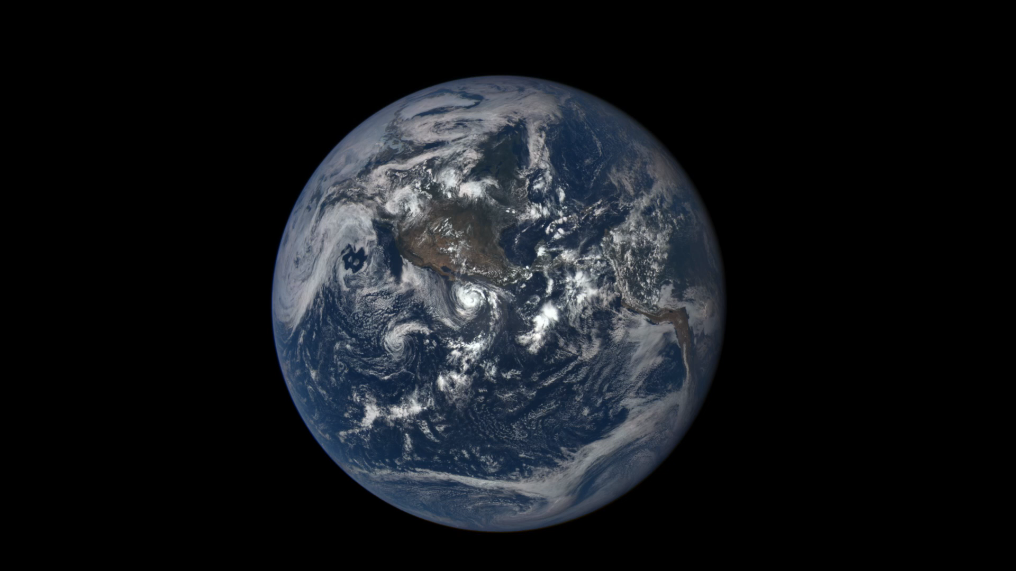
Low Orbit?
Geo Orbit?
Lagrange Orbit?
DSCOVR Credit: NASA

Slide 27

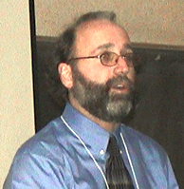

Fredric Raab
AMSAT CubeSat Simulator
John Moore
A3Sat Project
Lucas Moxey
TechRise

Slide 28
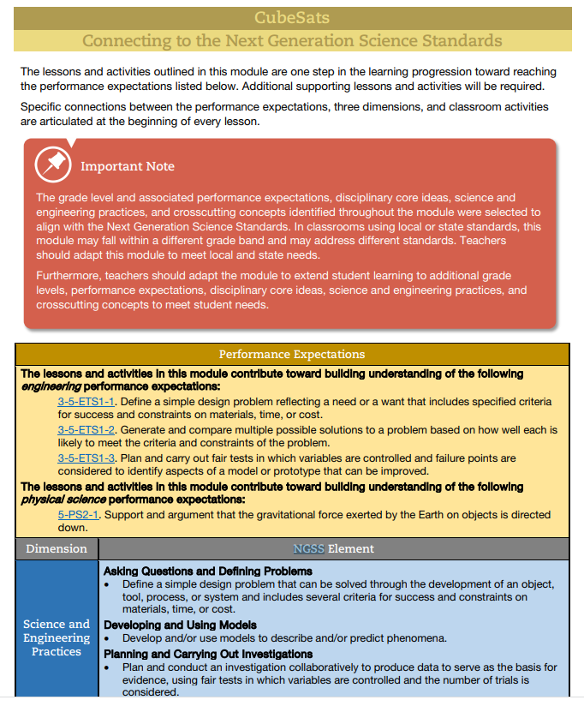
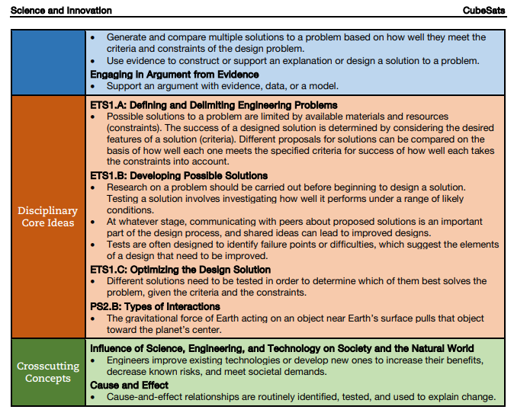
Teaching Channel CUBESATS Teach Handbook

Slide 29
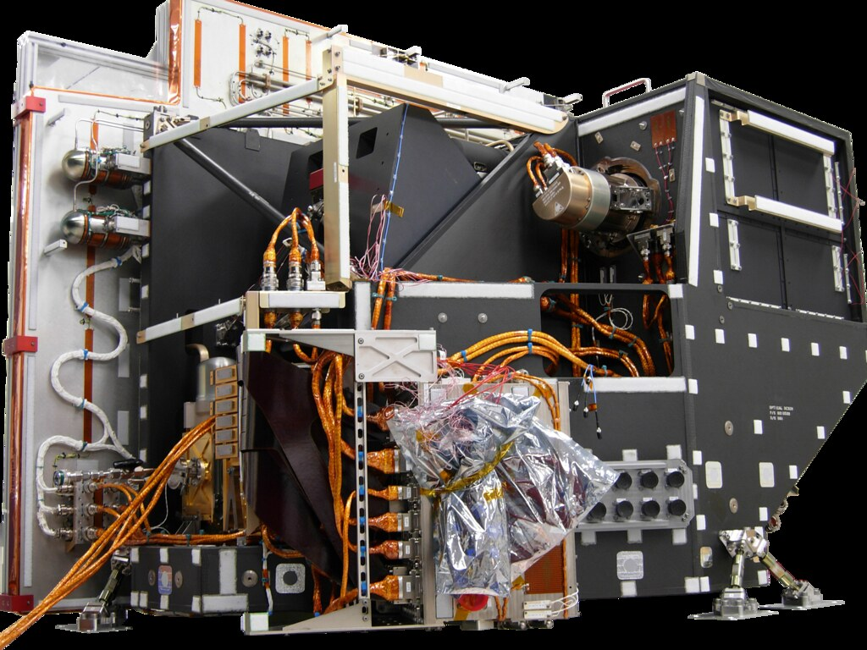
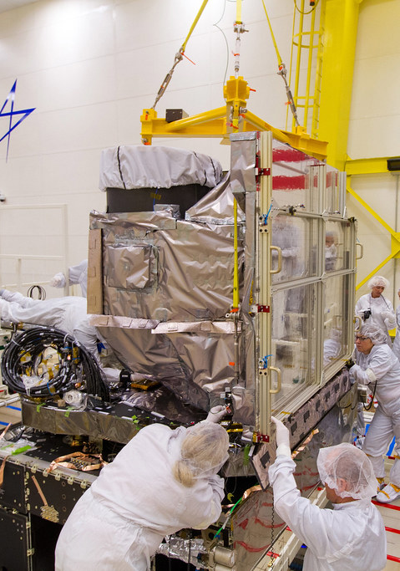
GOES ABI NASA/NOAA

Slide 30
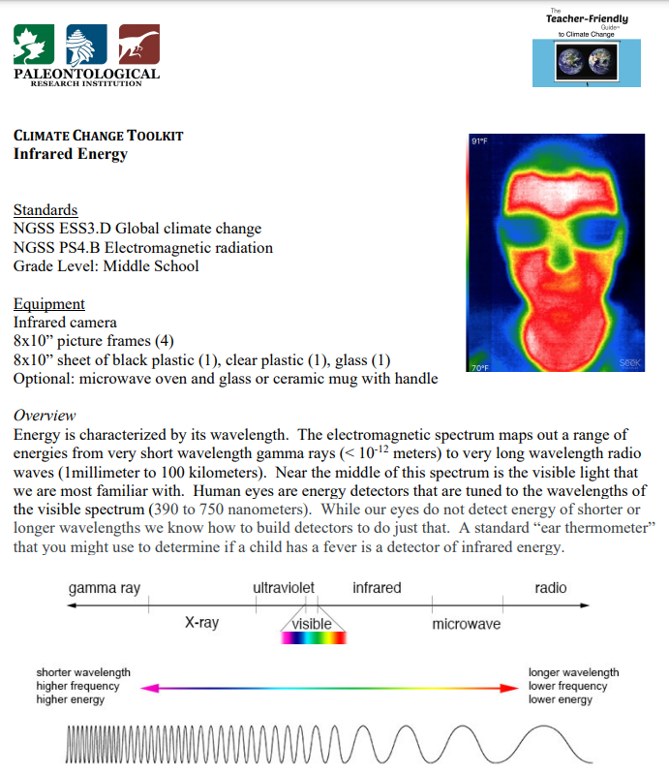

https://teachclimatescience.files.wordpress.com/

Slide 31
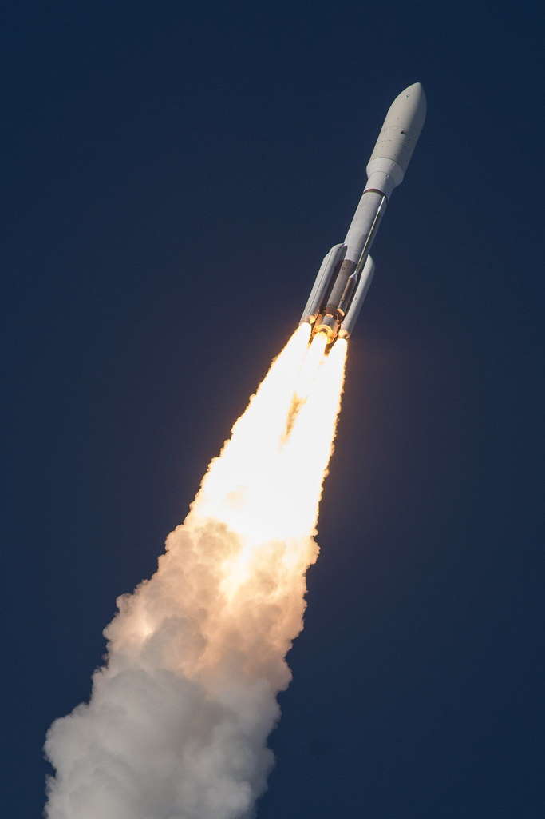

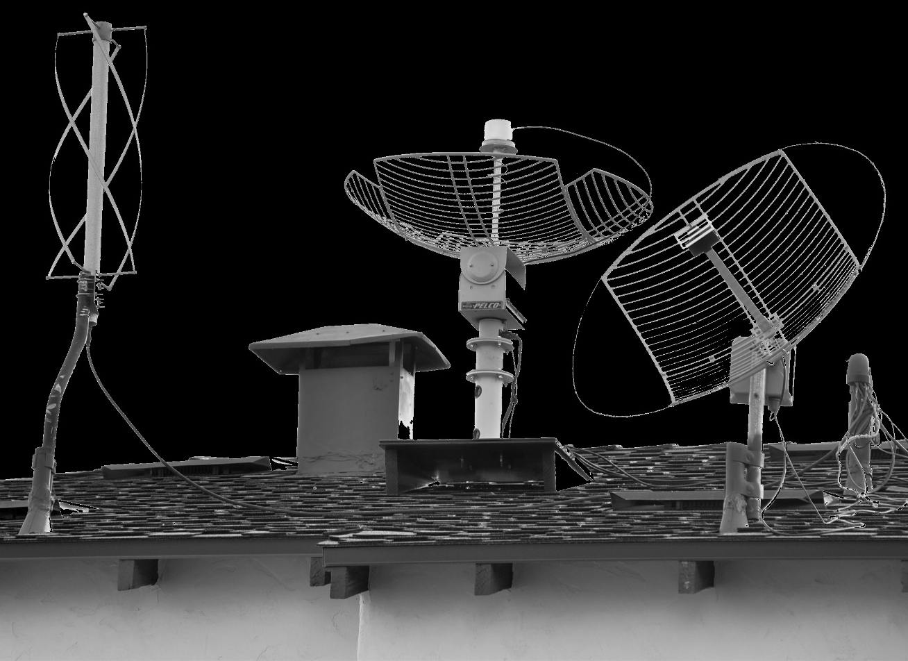
GOES S
NASA/NOAA
GOES ABI NASA/NOAA

Slide 32
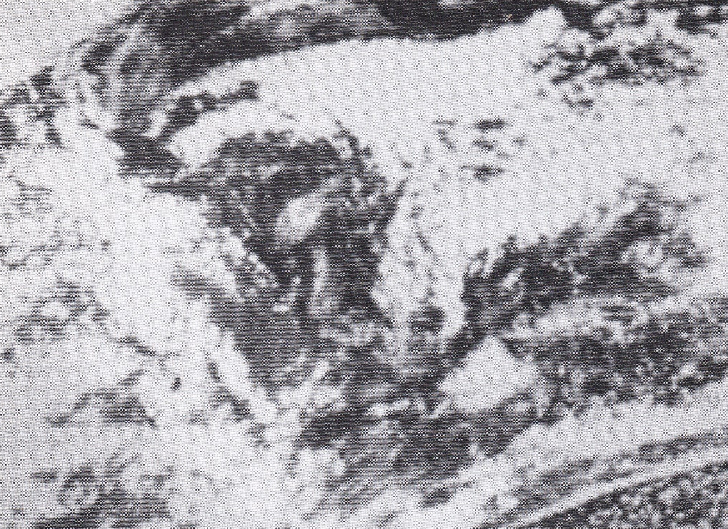

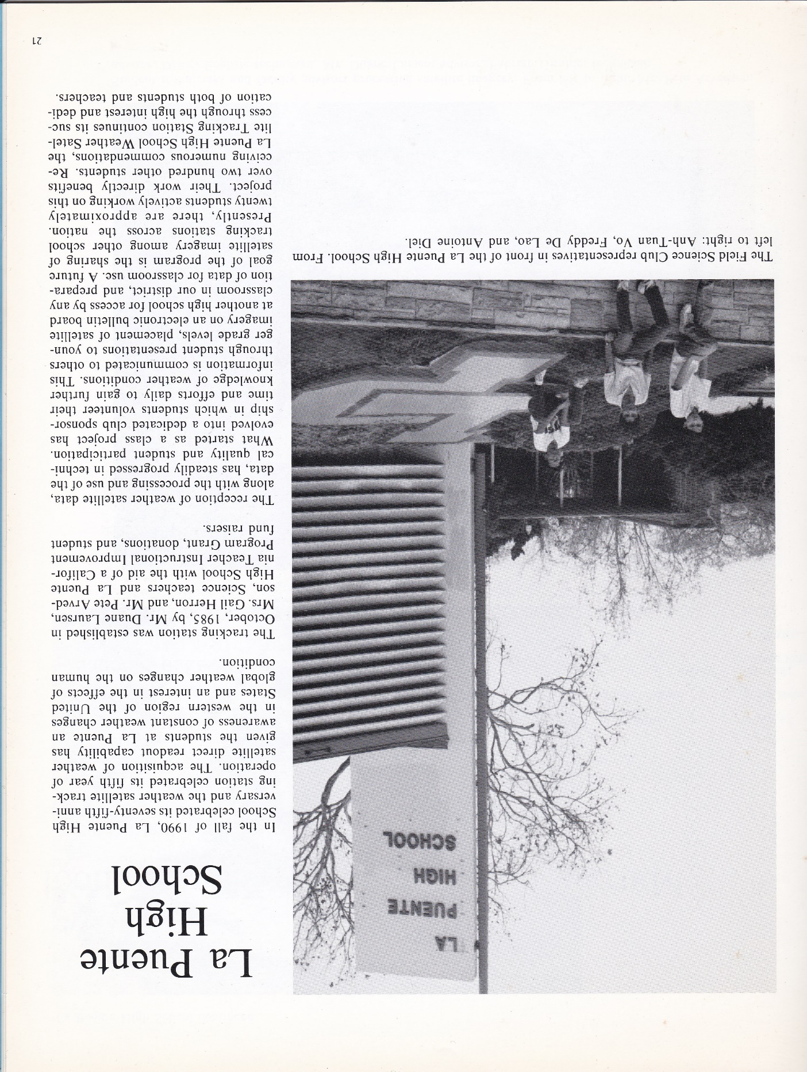


Slide 33
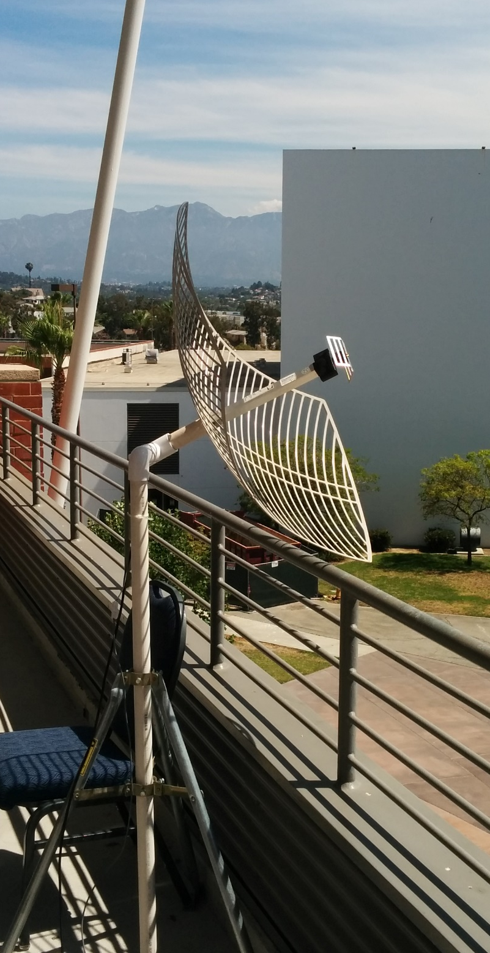
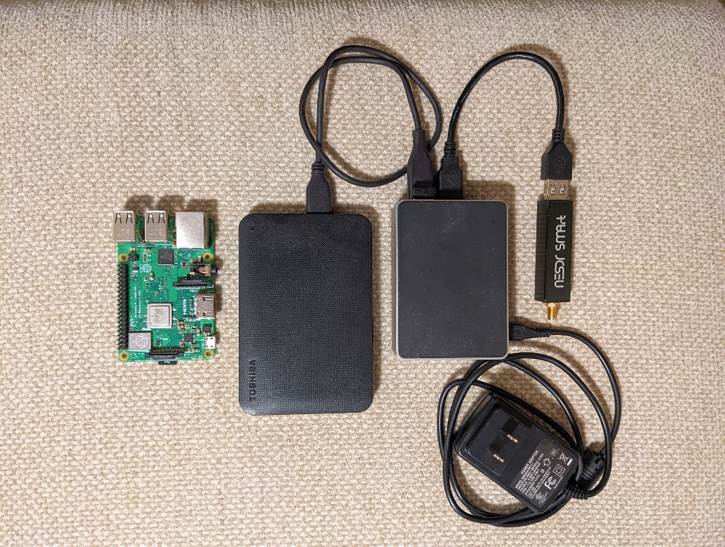
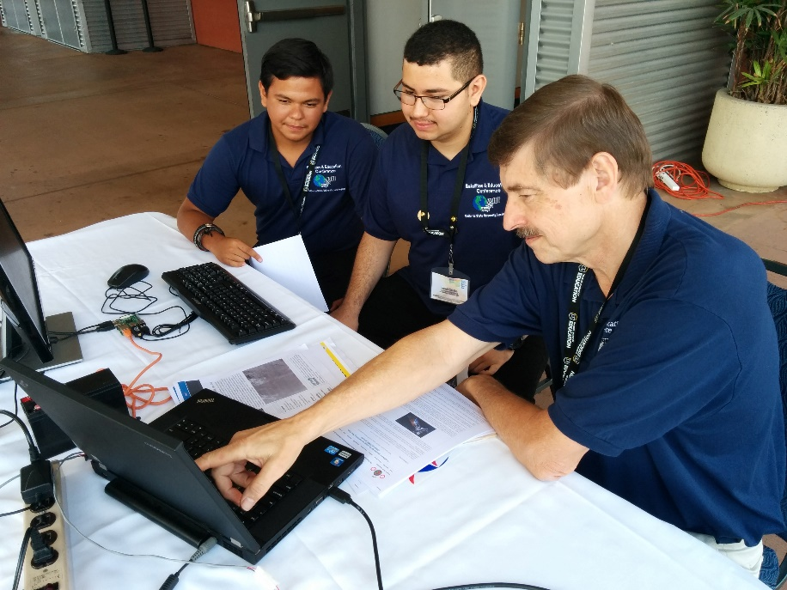
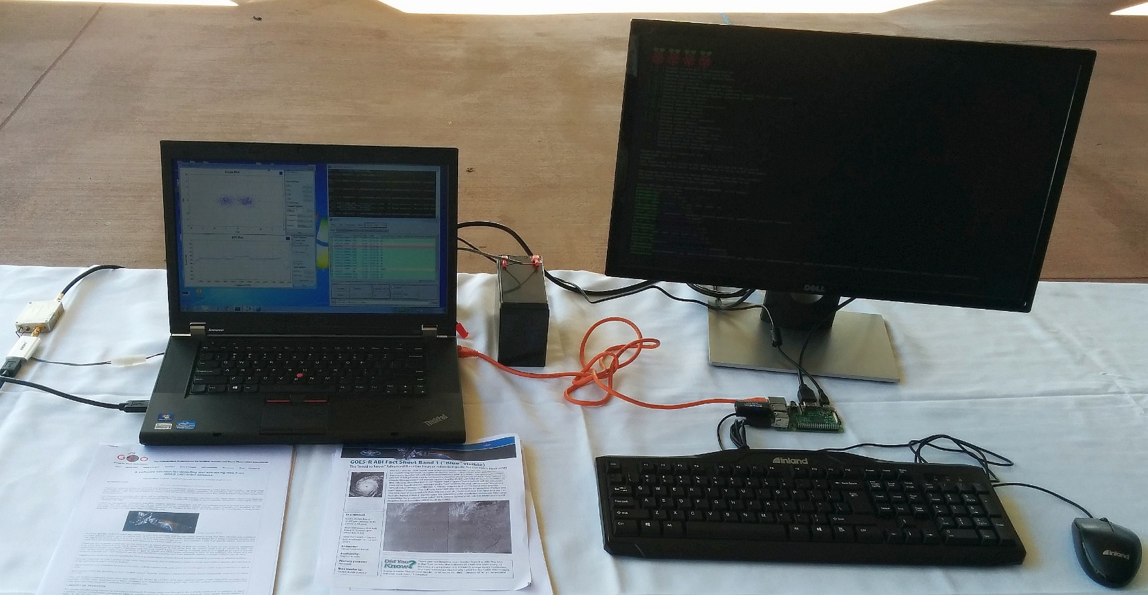

Slide 34
Thank You
Volunteers
Audience
Teachers Who Inspire
Now let’s head outside

